Slide 1
Facial Recognition Project
SAIT Information System Security program.
Carl Vincent Saban | Monte Kang | Jun Wang
Notes:
we all put out equal efforts throughout the project but for this presentation I'm going to explain the theory part, Vincent will be doing the problems, solutions and improvements And Jun will do the demo part.

Slide 2
AGENDA
Introduction
Facial Recognition Technology
Detail of the Project
Problems and Solutions
Ways to improve the project
DEMO TIME
Q&A.

Slide 3
Introduction

Slide 4
Introduction
What is our project?
• Build a facial recognition system with IFF functionality (system is able to differentiate between friends and foes), it scans faces of all users who access the system and add them to a database (only new faces should be added to the database), should have logging system (who accesses the system, times, new records in the database), and finally it should alert the user when a “foe” is detected.
• Build a two way authentication system: using username/password as the first way of authentication and biometric facial feature as the second way of authentication.

Slide 5
Introduction
Goal for the project
• The main goal of the project was to make a facial recognition system that can be run in a restricted room or area for surveillance and recording the information of accessed personnel.
• Develop a 2 way authentication system with functions adding new users and verify users’ credentials.
• Accuracy | Timing | Security
Notes:
• The main goal of the project was to make a facial recognition system that can be run in a restricted room or area for surveillance and recording the information of accessed personnel.
• Develop a 2 way authentication system with functions adding new users and verify users’ credentials.
• Accuracy:
To achieve the necessary level of accuracy of facial recognition is challenging. Our goal is to distinguish the identity of who is exposed to the surveillance camera. The model utilized in this project has an accuracy rate of 99.38%.
• Timing:
Our goal is to achieve real time processing of living streams captured by camera.
• Security:
To avoid SQL injection attack, users input should be sanitized for the 2 way authentication system. Passwords should be hashed before they are stored in the database.

Slide 6
Introduction
Achievement from the project
• Developed a face recognition system, with the function of automatically creating database tables and saving face features into the database.
• accuracy rate of 99.38%.
• 2 way authentication system with password and facial recognition
Notes:
Developed a face recognition system, with the function of automatically creating database tables and saving face features into the database.
The face_recognition model utilized in this project has an accuracy rate of 99.38%.
The python opencv model is able to capture 30 frames every second.
Our facial recognition processing speed reaches 6 frames every second.
For the 2 way authentication system, the input is properly sanitized and tested SQL injection proof. Passwords are properly hashed by sha512.

Slide 7
Facial Recognition Technology

Slide 8
Facial Recognition Technology
Facial Recognition Technology
Facial recognition technology (FRT) has emerged as an attractive solution to address many contemporary needs for identification and the verification of identity claims.
Facial recognition technology (FRT) allows the automatic identification of an individual by matching two or more faces from digital images.
Facial recognition refers to a multitude of technologies that can perform different tasks for different purposes. In this regard, a key distinction is whether facial recognition is used for verification or identification.
Notes:
Facial recognition technology (FRT) has emerged as an attractive solution to address many contemporary needs for identification and the verification of identity claims. It brings together the promise of other biometric systems, which attempt to tie identity to individually distinctive features of the body, and the more familiar functionality of visual surveillance systems.
Facial recognition technology (FRT) allows the automatic identification of an individual by matching two or more faces from digital images. It does this by detecting and measuring various facial features, extracting these from the image and, in a second step, comparing them with features taken from other faces.
Facial recognition refers to a multitude of technologies that can perform different tasks for different purposes. In this regard, a key distinction is whether facial recognition is used for verification or identification.

Slide 9
Facial Recognition Technology
Identification
Identification means that the template of a person’s facial image is compared to many other templates stored in a database to find out if his or her image is stored there. Facial recognition can help verify personal identity.
In this project, our real-time face recognition system (face_surveillance.py) is an example of utilizing identification technology. Identification is used based on facial images obtained from video cameras.
Notes:
Identification means that the template of a person’s facial image is compared to many other templates stored in a database to find out if his or her image is stored there. Facial recognition can help verify personal identity. It is a one to many comparison. If the person is not present In the database, It means we have never seen this person before. So you may either add them to the database or simply say that he/she is an unknown person. This can be used in applications like Surveillance, Attendance system etc.
In this project, our real-time face recognition system (face_surveillance.py) is an example of utilizing identification technology. Identification is used based on facial images obtained from video cameras. For this purpose, the system first needs to detect if there is a face on the video footage. Faces on video footage are extracted and then compared against the features of facial images in the reference database to identify whether the person on the video footage is in the database of images.

Slide 10
Facial Recognition Technology
Verification
Verification technology forms the base of the second authentication method of our 2 way authentication system. Facial Authentication is a form of biometric authentication that relies on the unique biological characteristics of an individual to verify that she is who she claims to be. The users are authenticated by verifying their faces as one credential to securely access their accounts.

Slide 11
Facial Recognition Technology
OpenCV
OpenCV (Open Source Computer Vision) is a library of programming functions for real-time computer vision. The face detection part of the project was made using an OpenCV Library and python model face-recognition.
The OpenCV library proved to be flexible enough for the project as it can accurately detect a face in real time and highlight it by drawing a rectangle around the faces passing by. While faces are being detected, the application analyzes every video frame for face recognition.
Notes:
OpenCV (Open Source Computer Vision) is a library of programming functions for real-time computer vision. The face detection part of the project was made using an OpenCV Library and python model face-recognition. The reason was that most Face APIs are restricted to doing detection on pictures only, the project was required to have face recognition done on a live video to speed up the process and achieve real-time face recognition.
The OpenCV library proved to be flexible enough for the project as it can accurately detect a face in real time and highlight it by drawing a rectangle around the faces passing by. While faces are being detected, the application analyzes every video frame for face recognition.

Slide 12
Facial Recognition Technology
OpenCV
Advantages:
• works almost real-time on CPU.
• Simple Architecture.
• Detects faces at different scales.
Disadvantages:
• The major drawback of this method is that it gives a lot of False predictions.
• Doesn’t work on non-frontal images.
• Doesn’t work under occlusion.
Notes:
Advantages:
• works almost real-time on CPU.
• Simple Architecture.
• Detects faces at different scales.
Disadvantages:
• The major drawback of this method is that it gives a lot of False predictions.
• Doesn’t work on non-frontal images.
• Doesn’t work under occlusion.
hjjjjjjjjjjjjjjjjjjju

Slide 13
Facial Recognition Technology
HoG Face Detector in Dlib (face_recognition)
The face_recognition module was built using dlib’s state-of-the-art face recognition built with deep learning.
This model is based on pre-trained models, meaning that the software develops rules for identification of faces based on a database of facial images.
This was possible through the increase in the availability of facial images at higher quality and the increase in computing power to process large amounts of data.
Notes:
The face_recognition module was built using dlib’s state-of-the-art face recognition built with deep learning. The model has an accuracy of 99.38% on the Labeled Faces in the Wild benchmark.
The face _recognition model is based on pre-trained models, meaning that the software develops rules for identification of faces based on a database of facial images.
This was possible through the increase in the availability of facial images at higher quality and the increase in computing power to process large amounts of data.
The face recognition model is trained on adults and does not work very well on children. It tends to mix up children quite easy using the default comparison threshold of 0.6.

Slide 14
Facial Recognition Technology
HoG Face Detector in Dlib (face_recognition)
Advantages:
Works very well for frontal and slightly non-frontal faces
Works under small occlusion
Easy to implement
Disadvantages:
It does not detect small faces as it is trained for a minimum face size of 80×80.
The bounding box often excludes part of forehead and even part of chin.
Does not work for side face and extreme non-frontal faces, like looking down or up.
Notes:
Advantages:
Works very well for frontal and slightly non-frontal faces
Works under small occlusion
Easy to implement
Disadvantages:
It does not detect small faces as it is trained for a minimum face size of 80×80.
The bounding box often excludes part of forehead and even part of chin.
Does not work for side face and extreme non-frontal faces, like looking down or up.

Slide 15
Detail of the Project

Slide 16

Detail of the Project
Operational and Environmental Requirements
• OS: Ubuntu 19.10
• Equipment: Webcam installed on the laptop
• Language: Python 3.7
•Database: MySQL
• Python module: OpenCV, Face_Recognition in Dlib

Slide 17
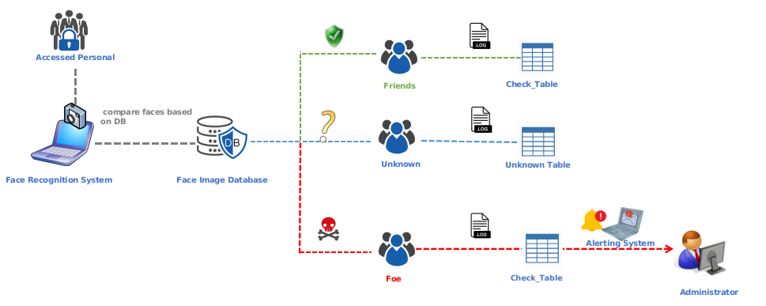
Detail of the Project
Main Structure
.

Slide 18
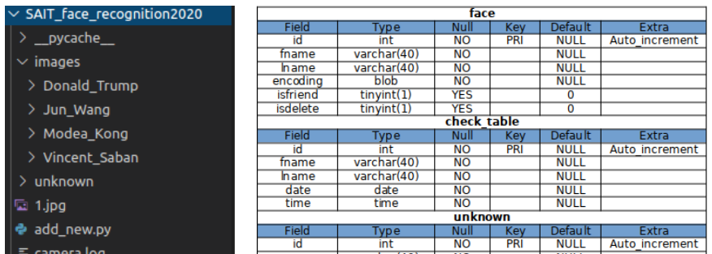
Detail of the Project
Database
We created 5 Mysql tables (face, check_table, unknown, users, usergroups) in iss database. There are three to six fields depending on the purpose of the table.
Notes:
• face: stores the known personal information, which includes id, first name, last name, face feature encoding and whether this person is a friend or a foe.
• check_table: stores record of known person who accesses the surveillance area including first name, last name, accessing date and time.
• unknown: stores the unknown personal information. It includes id, name, face feature encoding, accessing date and time and the image filename taking for the unknown person.
2 tables for the 2 way authentication system:
• users: stores the information of a registered user (id, username, password, encoding, gid).
• usergroups: stores the user group information, it can be used as permission control.

Slide 19
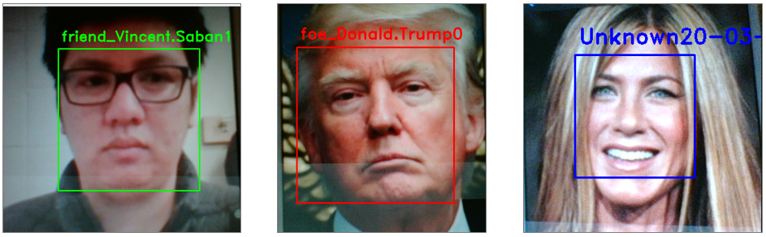
Detail of the Project
IFF function
Notes:
We utilized a “isfriend” variable in the mysql_functions.py and a column in the database table face. The value 1, means a friend, 0 means a foe. If a face is recognized as a known face means we found a match in our database, we will check the value of “isfriend” to determine which group the person is in. The result will then be displayed on the screen with a labeled frame around the detected face in the frame.

Slide 20
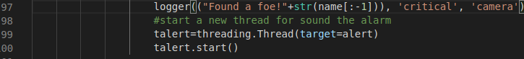
Detail of the Project
Alerting functions
• Playing alarm thread
• alerting email
Notes:
We implemented 2 methods for the alert system.
When a foe is found in one frame, the code will initiate a new thread to play the drip.ogg one time, which is an audio file commonly used in Linux alarm systems.
An alerting email will be sent to the administrator's email address, when one foe is recognized for the first time in a certain day.

Slide 21
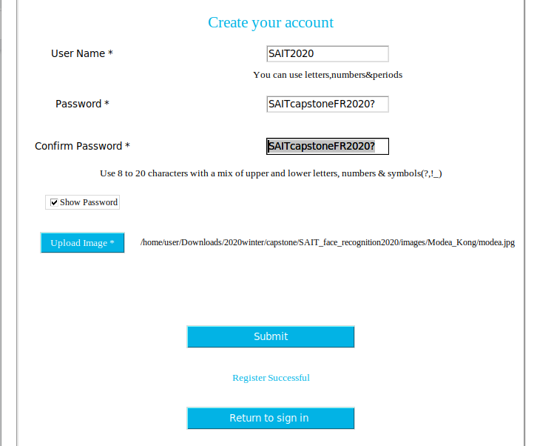
Detail of the Project
Sign up
Notes:
The sign up process includes sanitizing user input (username, password and the image file to upload), it compares the username with the database table “users”, makes sure the username is unique in the database. If it does not find a match in the database, it will extract the face feature in the image file and hash the password. Then a record of users will be inserted into the users table.

Slide 22
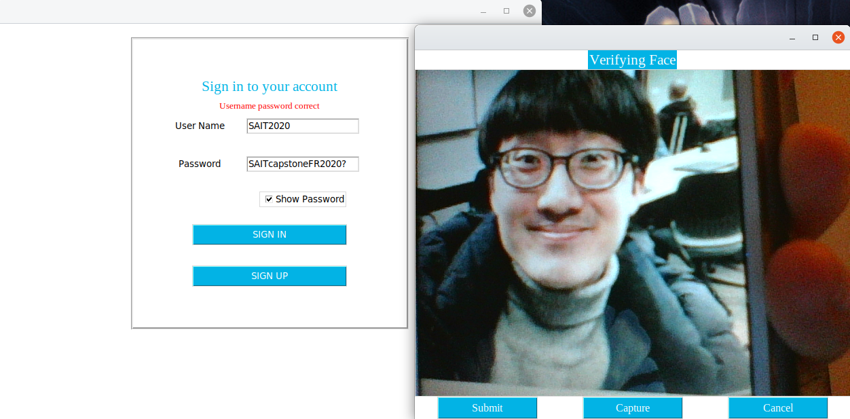
Detail of the Project
Sign in
Notes:
The sign in function is composed by sanitizing user input, username and password comparing the respective data in the database table users. When the SIGN IN button is clicked, It queries the database by the username which is stored in the database in plain text. If found a match, it will continue to call the hash function to decode the password in the database, if the password and username all match with the record in the database, a new window will pop up to verify the user's face. At the same time, the camera will be turned on to capture the face exposed. Click on the button Capture, the feature of the face will be extracted. When a user clicks on submit, the code will compare the username, password again, and the captured face feature with the encoding of this user's face which was stored in the database in the signup process. Only when all three credentials are verified, the user is allowed to login the system

Slide 23
Problems and Solutions

Slide 24
Problems and Solution
Using OpenCv
• Opencv doesn’t work with environments that is written in Qt. An example of that is Kde plasma desktop environment.
Only solution is to use operating system that uses GTK environment
i.e Ubuntu gnome environment
• Opencv has two packages (opencv-python and opencv-contrib-python).
Notes:
Opencv doesn’t work with environments that is written in Qt.
An example of that is Kde plasma desktop environment.
Only solution is to use operating system that uses GTK environment (i.e Ubuntu gnome environment (during the time of the writing, might have changed since then.)
Opencv has two packages (opencv-python and opencv-contrib-python).
Make sure to install the latter as that one have the contrib modules that we needed for our script to run.

Slide 25
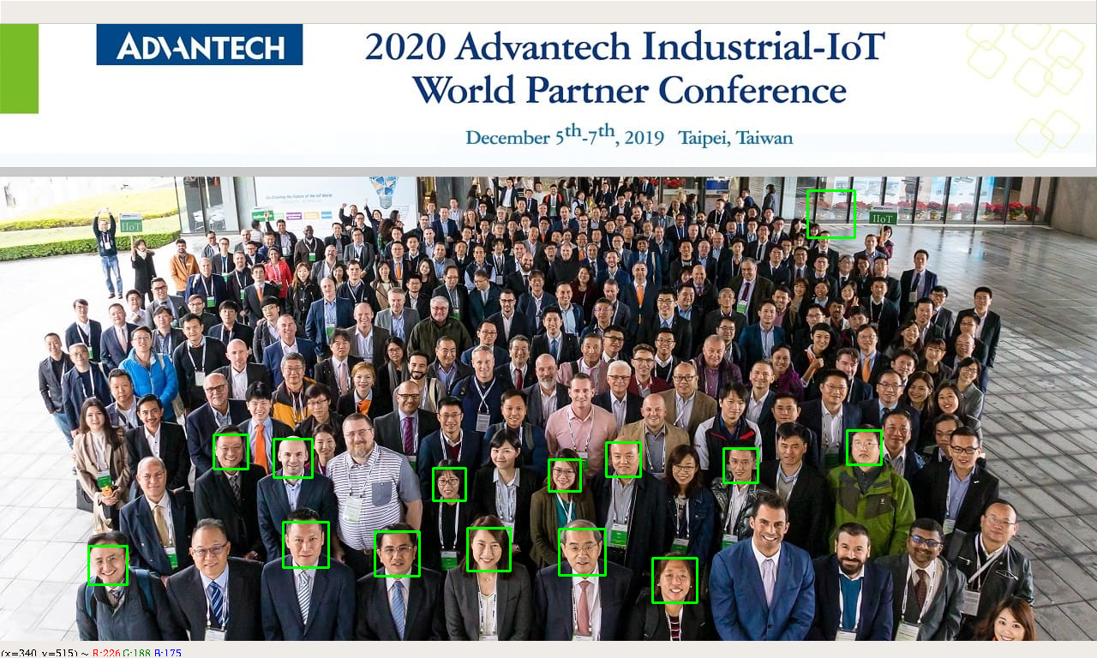
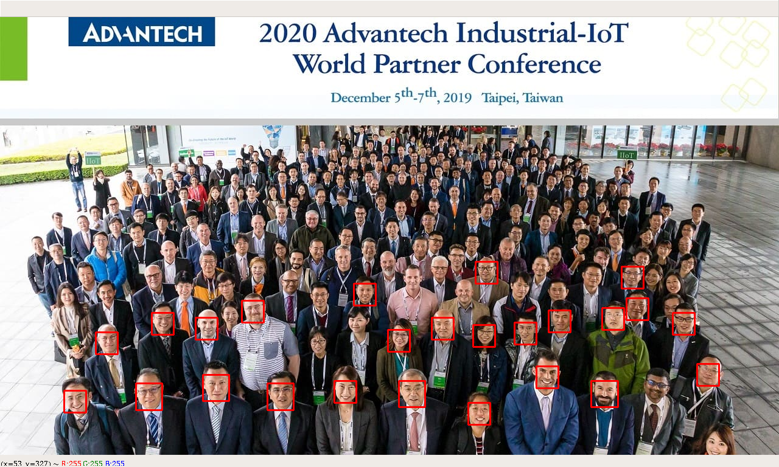
Problems and Solution
Choosing the face recognition module.
OpenCV with Haar_Cascade vs. Face_Recognition
Notes:
We had two main choices when choosing the face recognition module that would suit our needs.
It was opencv with the haar_cascade function and face_recogntion module.
Both have their pros and cons but ultimately, our choice was either if we wanted a faster program or a more accurate one and we went with the accurate route.

Slide 26
Problems and Solution
Implementing the alerts.
The face recognition process pauses when sending alerts.
• Before we apply the solution, when a foe is found, the alerting system runs in the major process. The face recognition had to pause and wait for the alerting process to finish. To solve this problem we implemented python multithreading module. By run alert system in separate threads, the major face recognition process runs without interference. This measure makes sure the face recognition system real-time.
• The email alert that we had is getting blocked by the SAIT firewall. we use our own phones hotspot so that it won’t use SAIT’s network.
Notes:
The face recognition process pauses when sending alerts.
Before we apply the solution, when a foe is found, the alerting system runs in the major process. The face recognition had to pause and wait for the alerting process to finish. To solve this problem we implemented python multithreading module. By run alert system in separate threads, the major face recognition process runs without interference. This measure makes sure the face recognition system real-time.
The email alert that we had is getting blocked by the SAIT firewall. The only work around for this is to use our own phones as a hotspot so that it won’t use SAIT’s network.

Slide 27
Ways to improve the project

Slide 28
Ways to improve the project
MTCNN module
we could improve the accuracy using other machine learning methods. MTCNN which uses tensorflow on its backend, would increase the accuracy of the program and the range of how far it can detect faces.
Advantage:
• Can identify more faces than the other two.
• Can identify faces from a far.
Notes:
we could improve the accuracy using other machine learning methods. MTCNN which uses tensorflow on its backend, would increase the accuracy of the program and the range of how far it can detect faces.

Slide 29
Ways to improve the project
Using better hardware
We can apply knowledge distillation to compress the current model and further reduce the model size using low bit quantization. Better hardware is another option to improve this project, while doing this project we were only using SAIT’s Toshiba laptop, which only has an i5, an integrated graphics card and the laptop's integrated camera. Doing this project with better hardware would have completely changed on how we approached our project. Instead of finding modules that could barely work on our machines, we could have expanded our search and used some of the GPU extensive modules that use machine learning to detect and recognize faces.
Notes:
we can apply knowledge distillation to compress the current model and further reduce the model size using low bit quantization. Better hardware is another option to improve this project, while doing this project we were only using SAIT’s Toshiba laptop, which only has an i5, an integrated graphics card and the laptop's integrated camera. Doing this project with better hardware would have completely changed on how we approached our project. Instead of finding modules that could barely work on our machines, we could have expanded our search and used some of the GPU extensive modules that use machine learning to detect and recognize faces.

Slide 30
DEMO TIME

Slide 31
DEMO TIME
(1) Facial Recognition
(2) Logging Files
(3) Log-in System with Authentication
(4) Email

Slide 32
Q & A

Slide 33
Thanks.
Facial Recognition Project
Carl Vincent Saban | Monte Kang | Jun Wang

Slide 34
REFERENCE
https://github.com/ageitgey/face_recognition
http://www.csc.kth.se/~vahidk/papers/KazemiCVPR14.pdf
https://medium.com/@ageitgey/machine-learning-is-fun-part-4-modern-face-recognition-with-deep-learning-c3cffc121d78
https://www.pyimagesearch.com/2018/06/18/face-recognition-with-opencv-python-and-deep-learning/
https://www.learnopencv.com/face-detection-opencv-dlib-and-deep-learning-c-python/
http://blog.dlib.net/2016/10/easily-create-high-quality-object.html
https://pypi.org/project/mtcnn/

